Slide 1
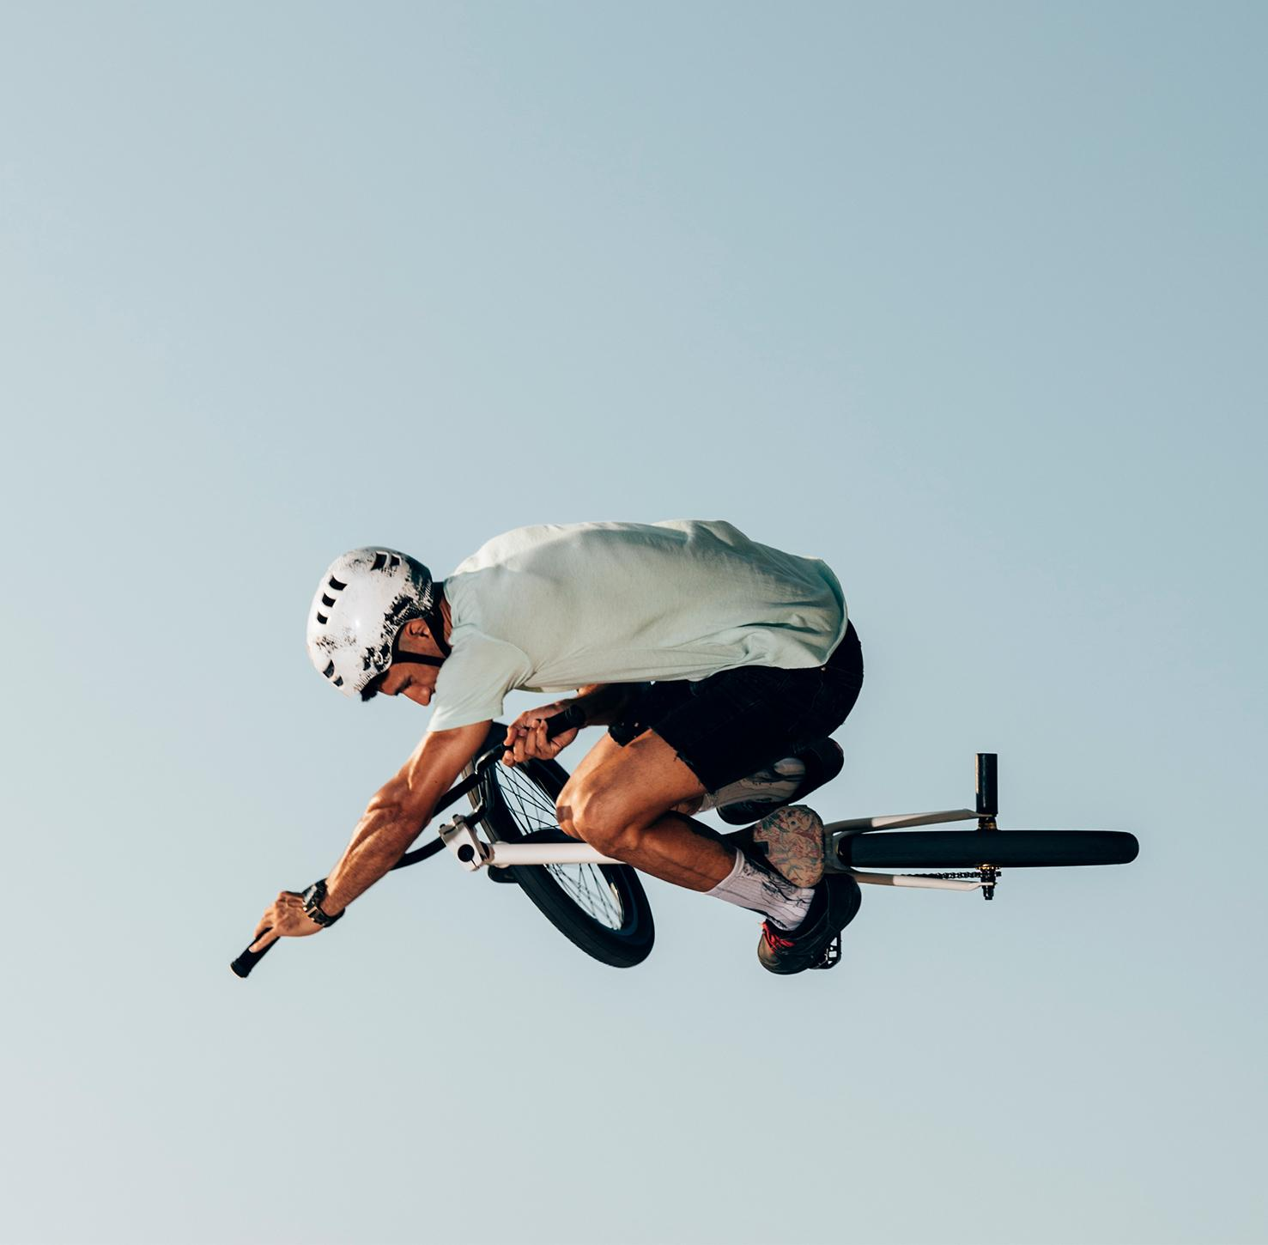
Fast Food Pink Panther Crikvenica
Službeni Style Guide

Slide 2
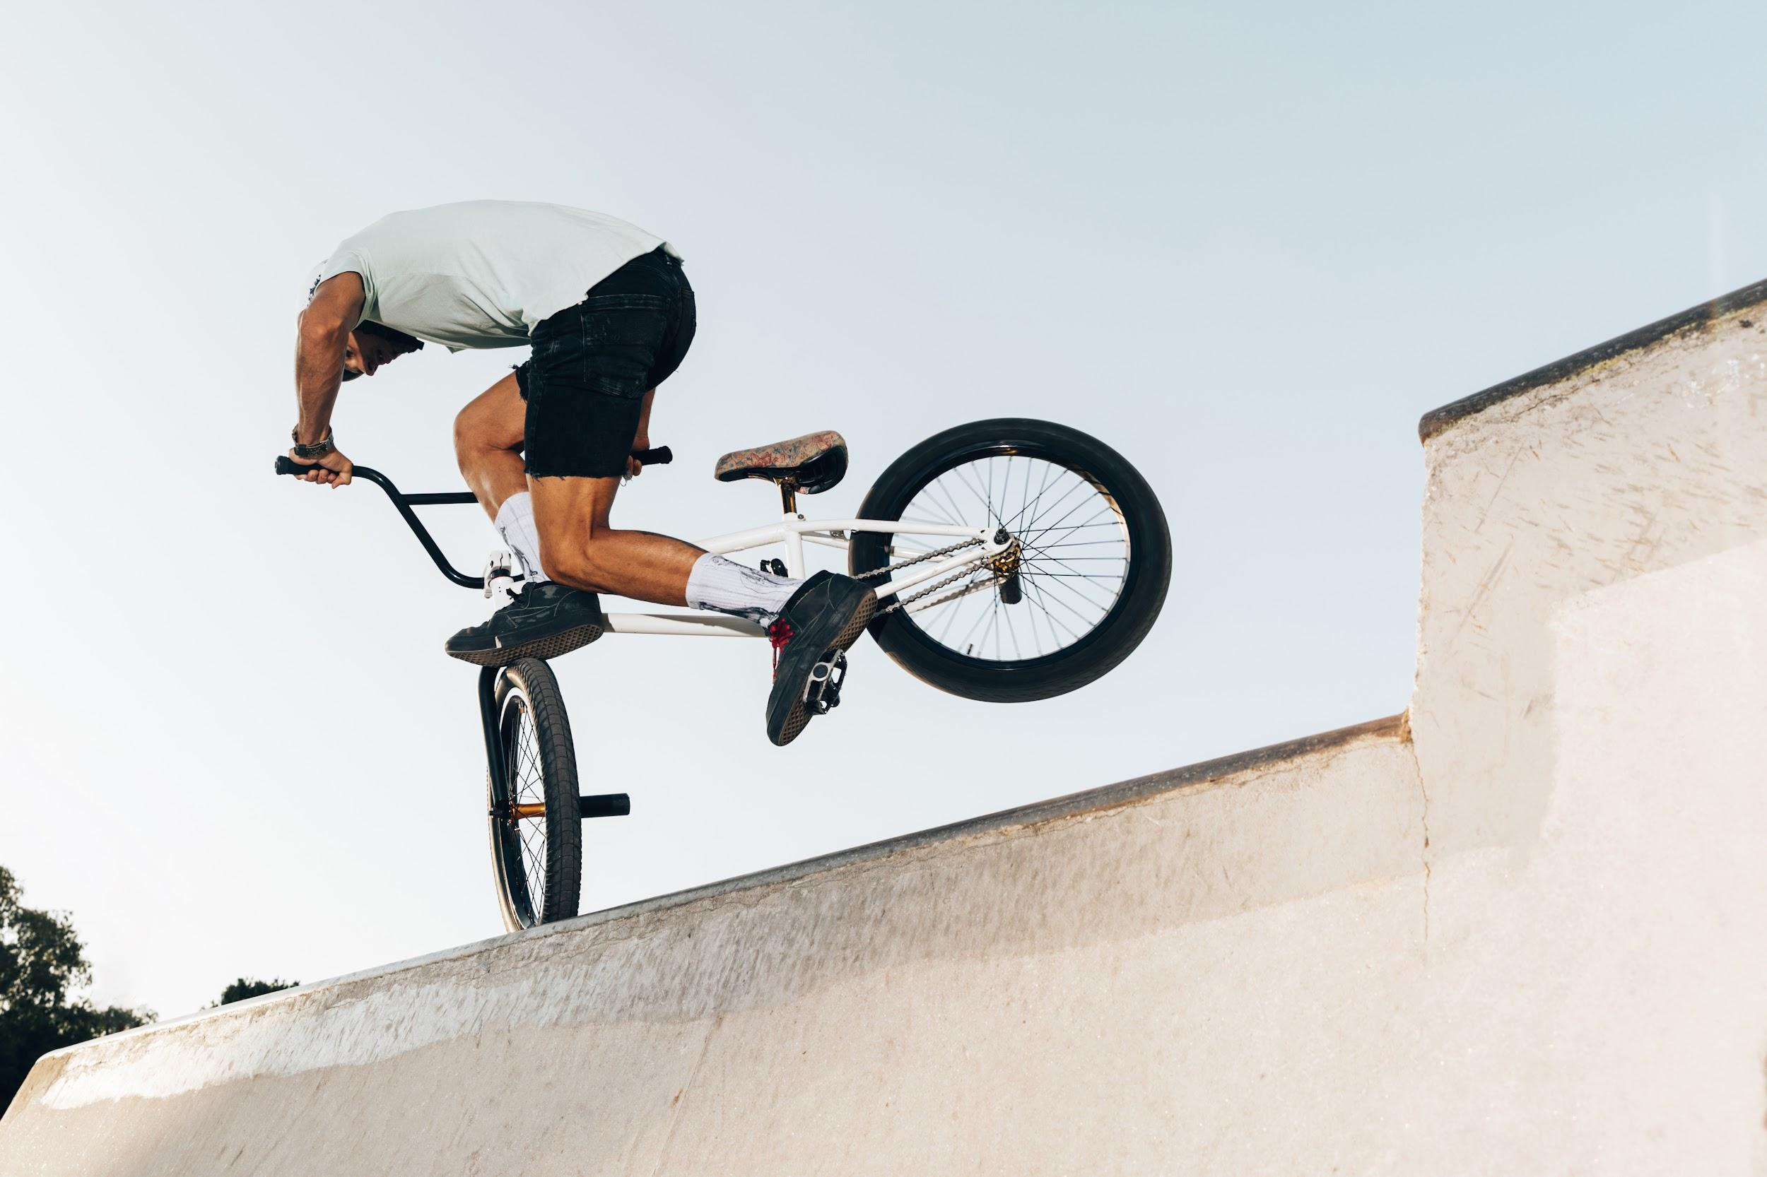
TABLE OF CONTENTS
01
02
03
Our logo
Here you could describe the topic of the section
Color standards
Here you could describe the topic of the section
Typography
Here you could describe the topic of the section

Slide 3
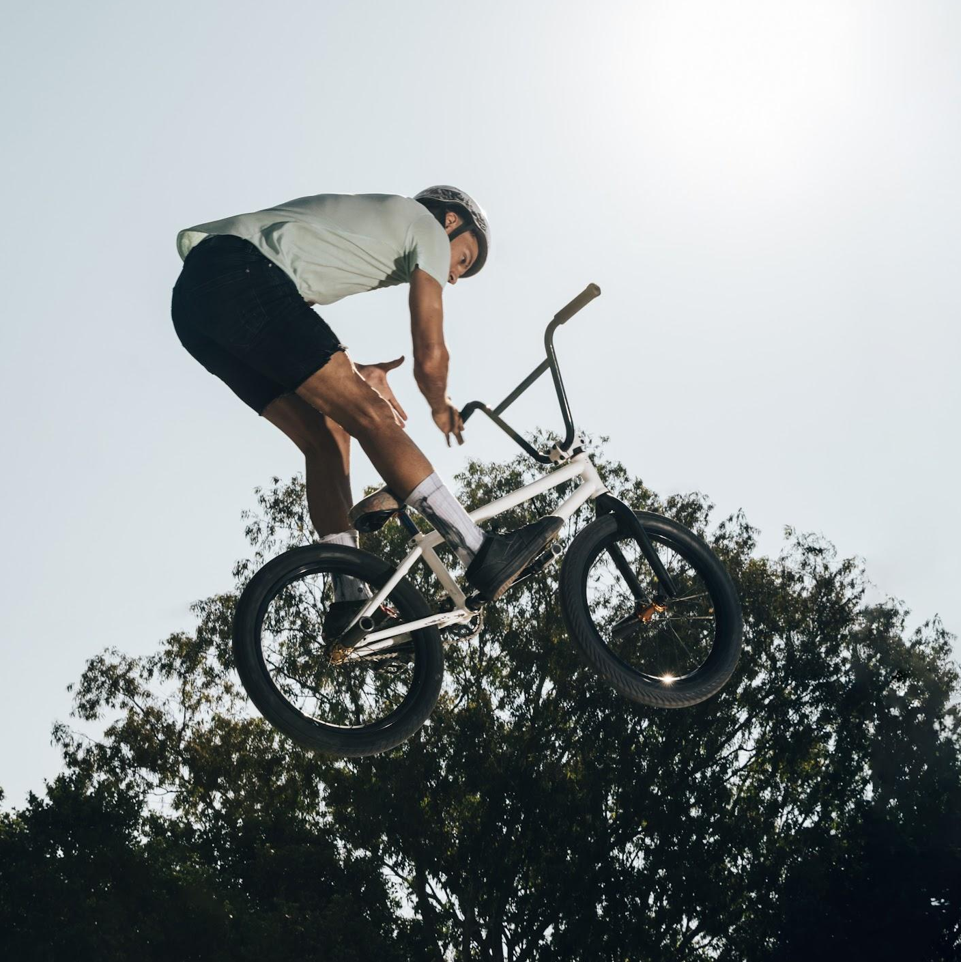

INTRODUCTION
Mercury is the closest planet to the Sun and the smallest one in our Solar System—it’s only a bit larger than the Moon

Slide 4
01
OUR LOGO
You can enter a subtitle here if you need it

Slide 5
PERSONALITY
Mars
Jupiter
Saturn
Despite being red, Mars is a cold place full of iron oxide dust
Jupiter is a gas giant and the biggest planet in the Solar System
Saturn is composed mostly of hydrogen and helium

Slide 6
LOGO

Slide 7
LOGO CONCEPT
Mercury is the closest planet to the Sun and the smallest one in our Solar System—it’s only a bit larger than the Moon. The planet’s name has nothing to do with the liquid metal, since Mercury was named after the Roman messenger god

Slide 8
OUR CREATIVE PROCESS
01
02
03
04
Mars
Mercury
Jupiter
Saturn
Mars is a really cold place unlike Venus
Mercury is the smallest planet
Jupiter is the biggest planet
Saturn is a gas giant and has rings

Slide 9
BRAND CONSTRUCTION
5px
5px
Venus has a beautiful name and is the second planet from the Sun. It’s terribly hot—even hotter than Mercury—and its atmosphere is extremely poisonous

Slide 10
DIMENSIONS
25mm
15mm
150px
100px
60px
Print
Digital
Jupiter is a gas giant and the biggest planet of them all in the Solar System
Saturn is a gas giant and has rings. It’s composed mostly of hydrogen and helium

Slide 11
CLEAR SPACE REQUIREMENTS
Despite being red, Mars is actually a cold place. It’s full of iron oxide dust, giving the planet its reddish cast

Slide 12
DOS
Here you can describe the correct uses of your logo
Here you can describe the correct uses of your logo
Here you can describe the correct uses of your logo

Slide 13
DON’TS
Here you can describe the incorrect uses of your logo
Here you can describe the incorrect uses of your logo
Here you can describe the incorrect uses of your logo

Slide 14
02
COLOR STANDARDS
You can enter a subtitle here if you need it

Slide 15
COLOR STANDARDS
#722d59ff
#a15887ff
#a7d5e9ff
#537686
CMYK: 52 92 38 24
RGB: 115 45 89
CMYK: 36 16 14 0
RGB: 163 190 203
CMYK: 28 15 15 0
RGB: 183 198 204
CMYK: 74 64 62 62
RGB: 41 46 48

Slide 16
COLOR GUIDELINES
3 Colors
Positive (1 color)
Negative (1 color)
Despite being red, Mars is a cold place full of iron oxide dust
Mercury is the smallest planet in the Solar System
Jupiter is the biggest planet in the Solar System

Slide 17
03
TYPOGRAPHY
You can enter a subtitle here if you need it

Slide 18
TYPOGRAPHY
Aa
Aa
Anton
Aa Bb Cc Dd Ee Ff Gg Hh Ii Jj Kk Ll Mm Nn Oo Pp Qq Rr Ss Tt Uu Vv Ww Yy Zz
Raleway
Aa Bb Cc Dd Ee Ff Gg Hh Ii Jj Kk Ll Mm Nn Oo Pp Qq Rr Ss Tt Uu Vv Ww Yy Zz

Slide 19

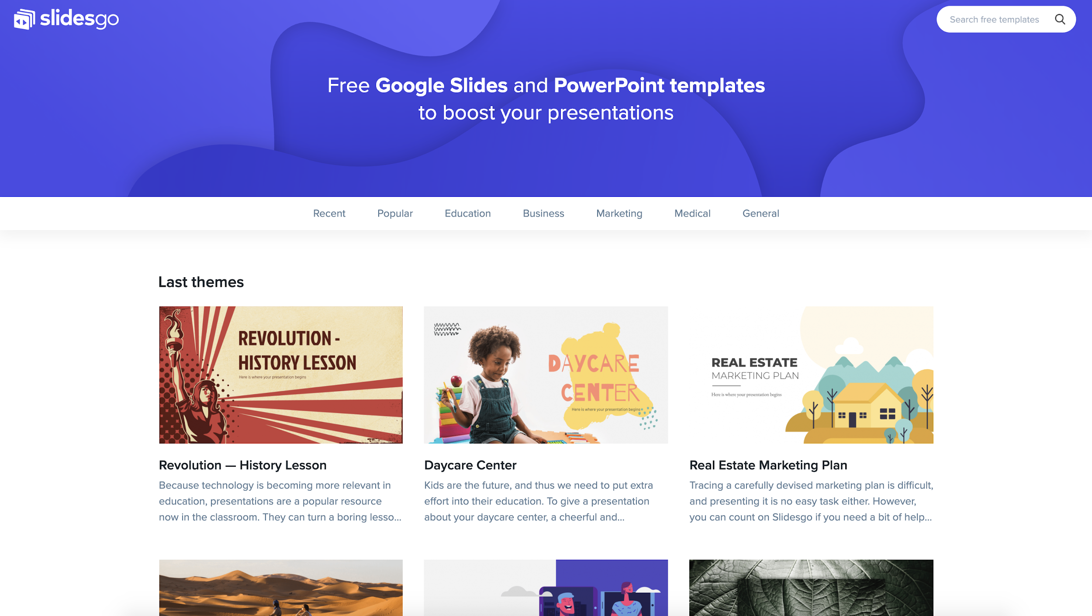
Mockup
You can replace the image on the screen with your own work. Just delete this one, add yours and center it properly

Slide 20
ICONOGRAPHY

Slide 21
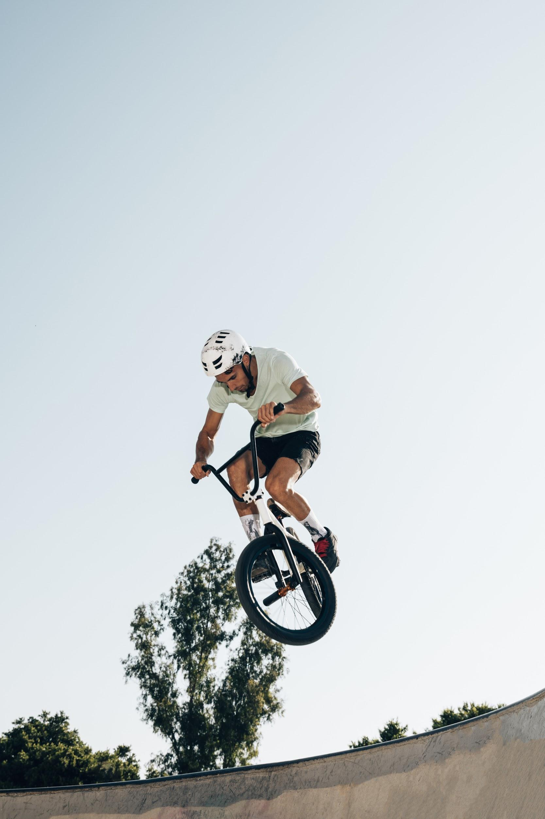
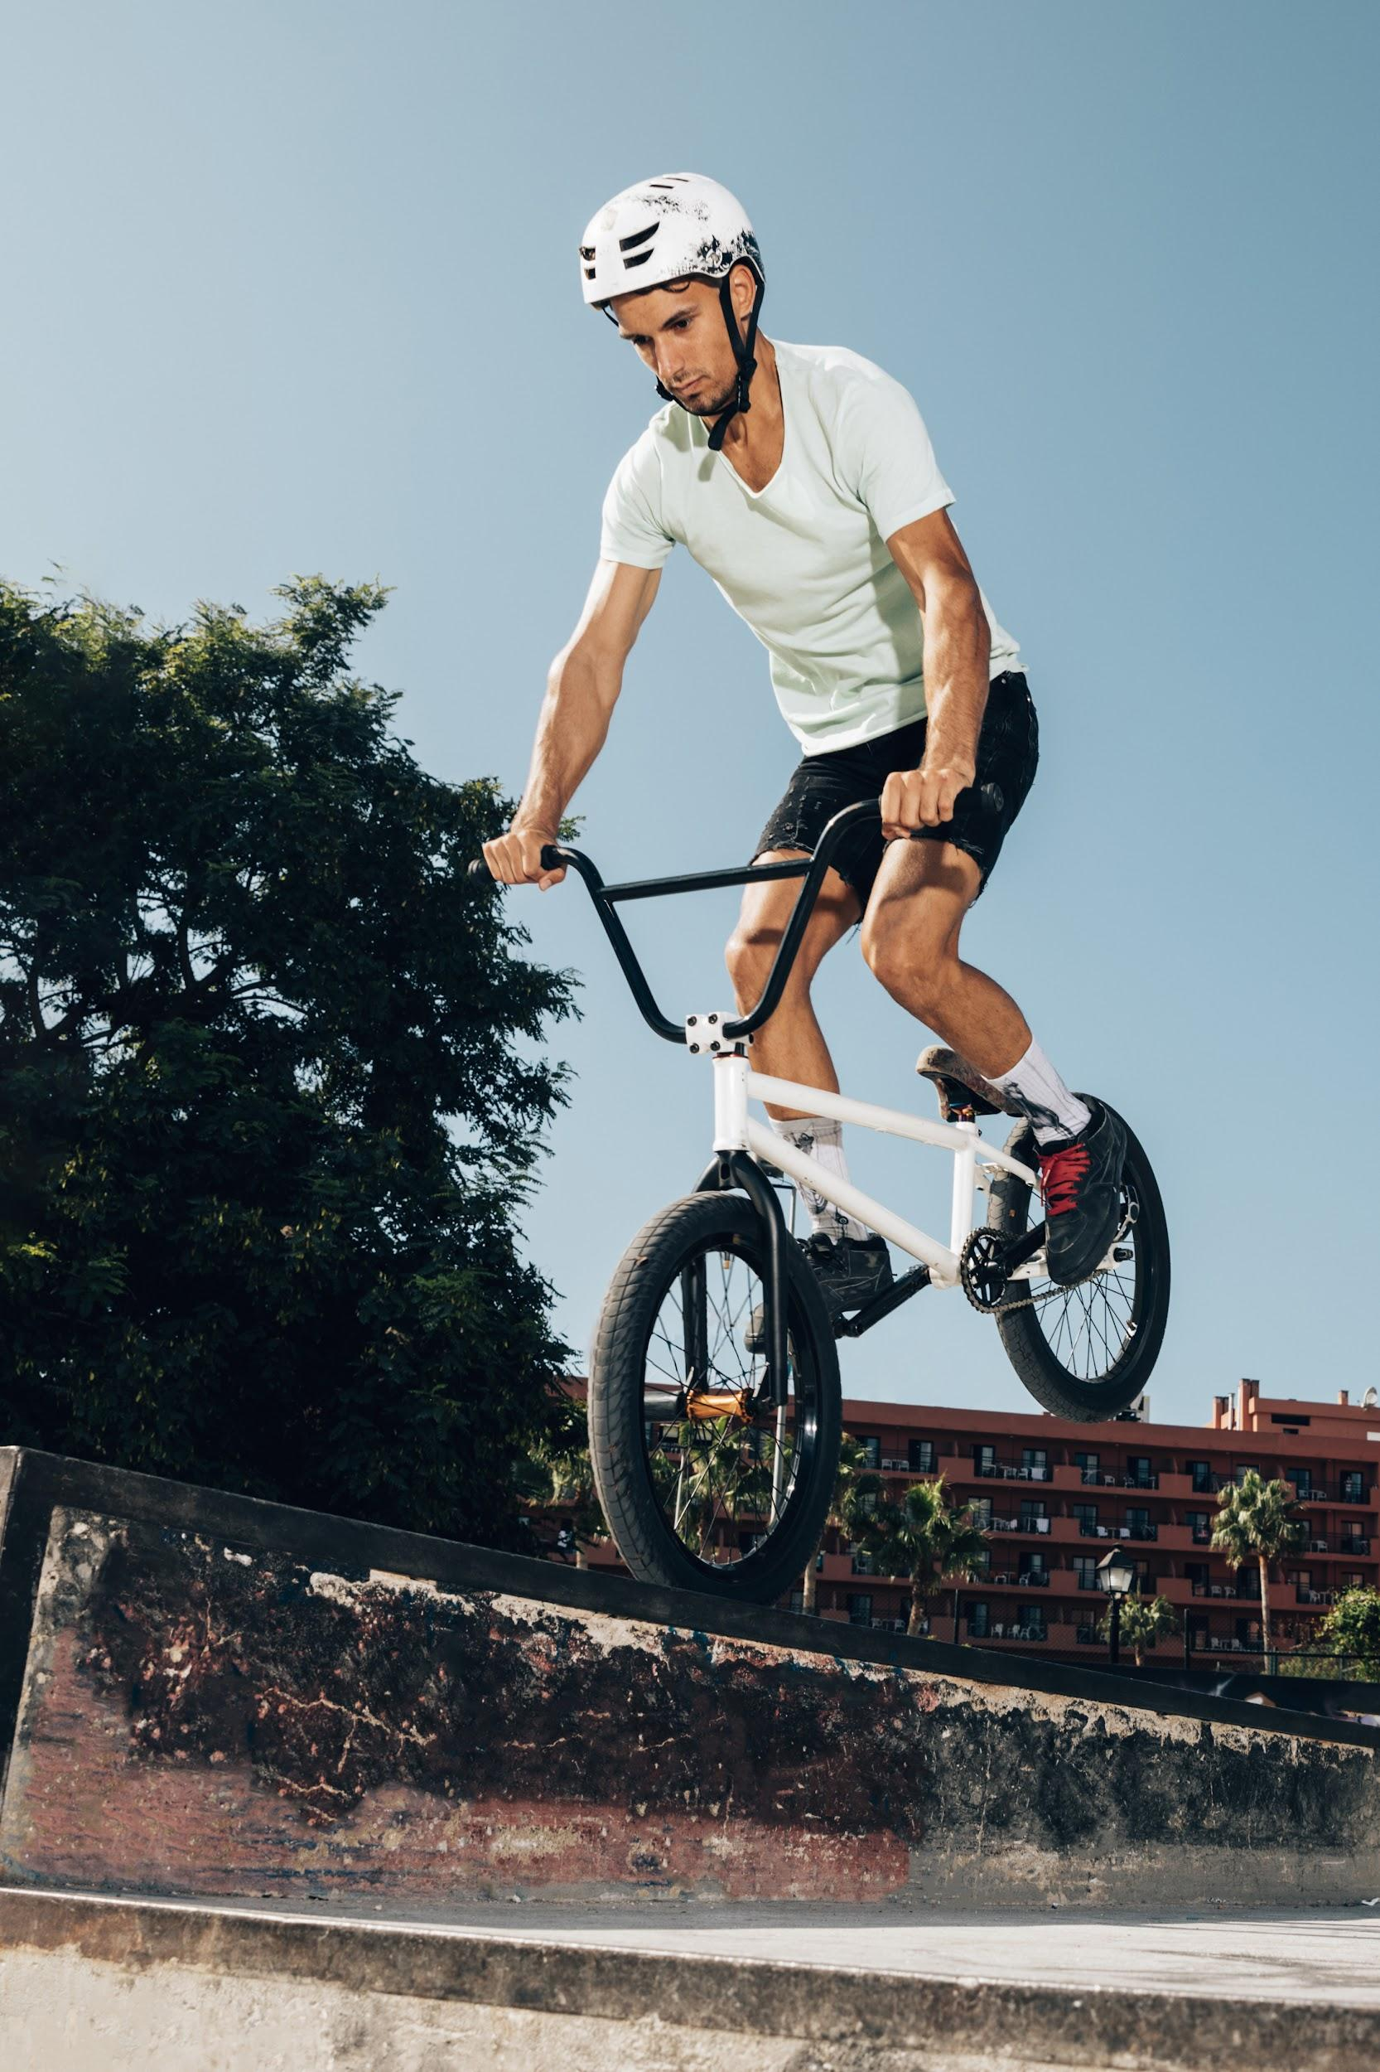
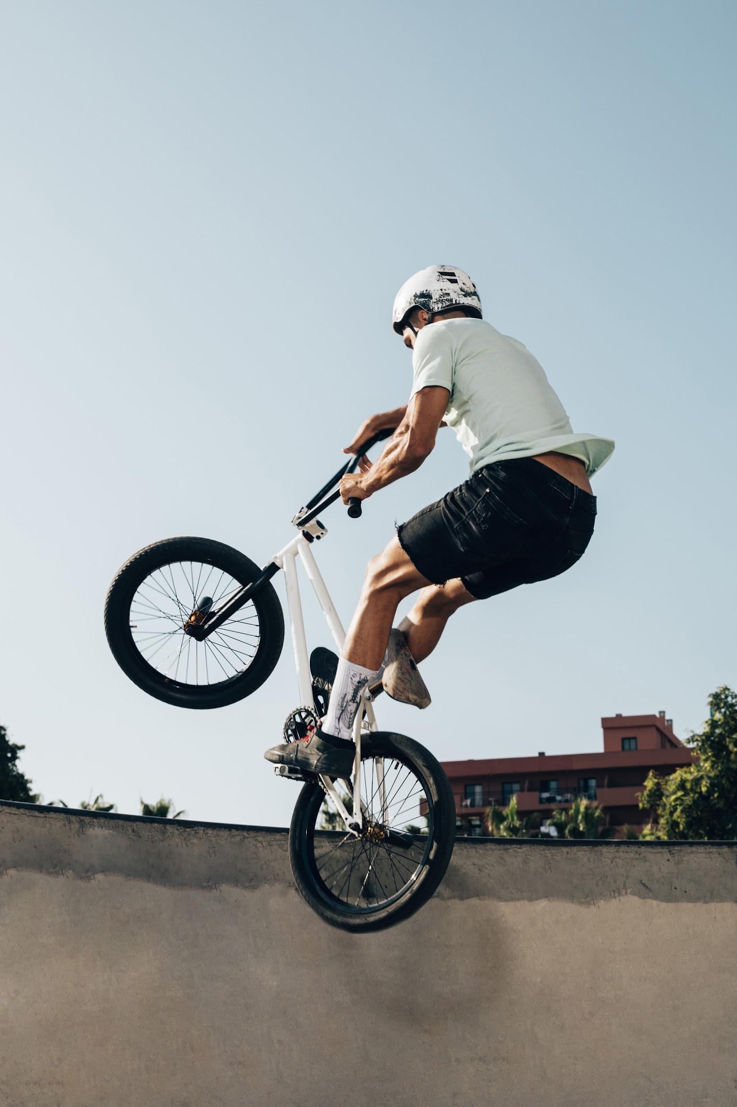

IMAGE GUIDELINES
Venus has a beautiful name and is the second planet from the Sun. It’s terribly hot, even hotter than Mercury

Slide 22
IMAGE CONCEPT
Mercury is the closest planet to the Sun and the smallest one in the Solar System—it’s only a bit larger than the Moon

Slide 23
BRAND VOICE
Saturn is a gas giant and has several rings
Neptune is the farthest planet from the Sun

Slide 24
OUR TAGLINE
“PLACE YOUR TAGLINE HERE”
Venus has a beautiful name and is the second planet from the Sun. It’s terribly hot

Slide 25
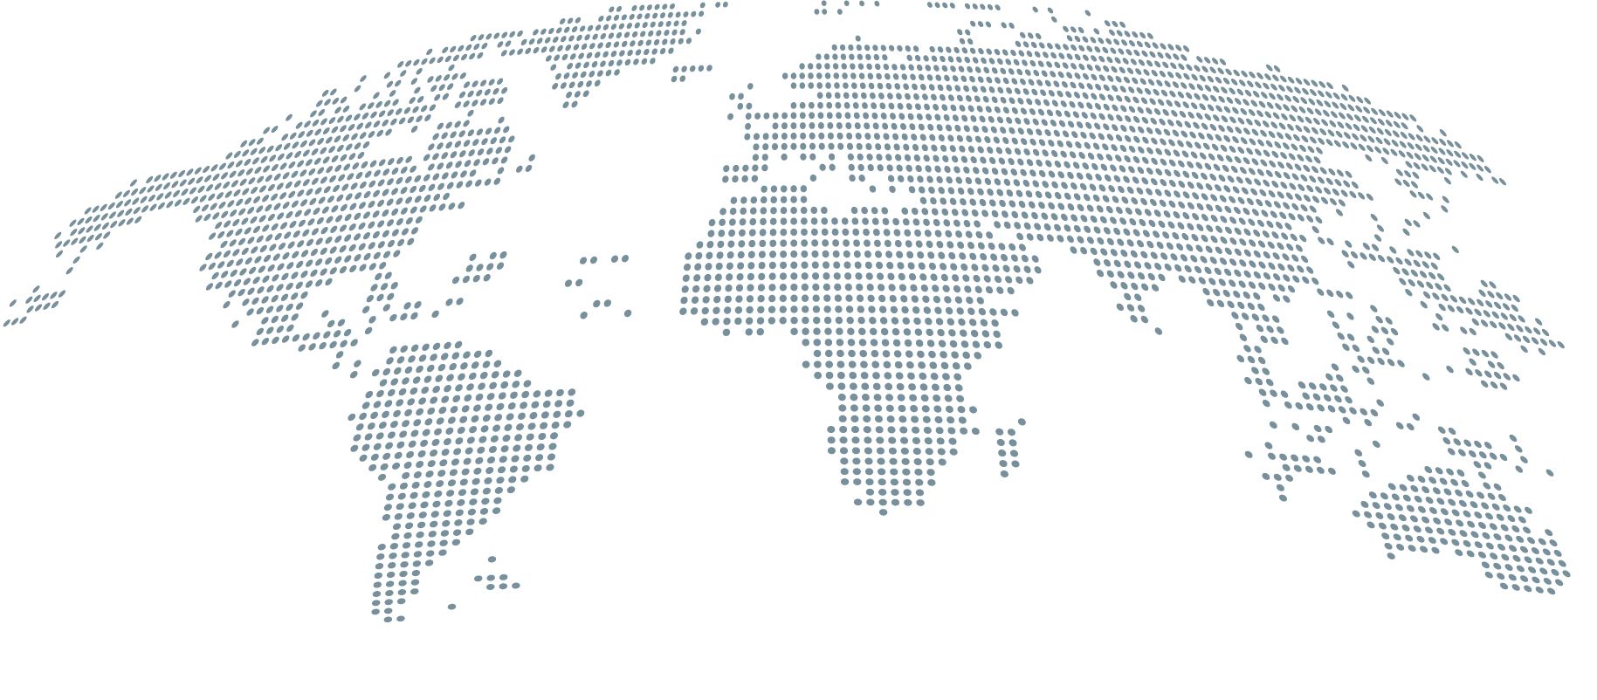
HEADQUARTERS
Jupiter
Jupiter is the biggest planet in the Solar System
Mars
Despite being red, Mars is actually a cold place

Slide 26
OUR HISTORY
1
2
3
4
Venus is the second planet from the Sun
Saturn is a gas giant and has several rings
Despite being red, Mars is a cold place
Mercury is the closest planet to the Sun

Slide 27
INFOGRAPHIC
Despite being red, Mars is actually a cold place
Venus has a beautiful name, but is really hot
Jupiter is the biggest planet in the Solar System

Slide 28
THESE ARE THE PERCENTAGES
15%
30%
45%
100%
Despite being red, Mars is actually a cold place
Venus is the second planet from the Sun
Saturn is composed of hydrogen and helium
It’s the biggest planet in the Solar System

Slide 29
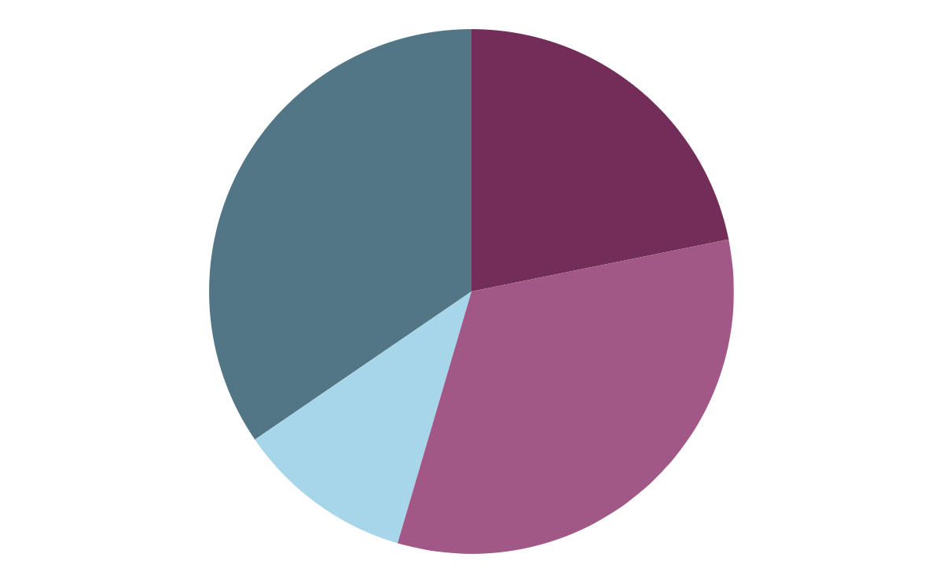
YOU MAY NEED A GRAPH
34.5 %
28.1 %
10.9 %
32.7 %
To modify this graph, click on it, follow the link, change the data and paste the resulting graph here

Slide 30
OR A TABLE
TABLE
... | Mass | Diameter | Gravity
Mars | 0.11 | 0.53 | 0.38
Venus | 95.2 | 9.4 | 1.16
Earth | 2.50 | 115.0 | 2.0
Jupiter | 11.0 | 24.5 | 22.5

Slide 31
333,000.00
earths is the Sun’s mass
24h 37m 23s
is Jupiter’s rotation period
386,000 km
is the distance between Earth and the Moon

Slide 32

“This is a quote, words full of wisdom that someone important said and can make the reader get inspired.”
—Someone Famous

Slide 33
BRAND CONCEPTS
Mercury
Venus
Mars
It’s the smallest planet of them all
Venus has a really beautiful name
Despite being red, Mars is a cold place
Jupiter
Saturn
Neptune
It’s the biggest planet in the Solar System
It’s a gas giant and has multiple rings
It’s the farthest planet from the Sun

Slide 34
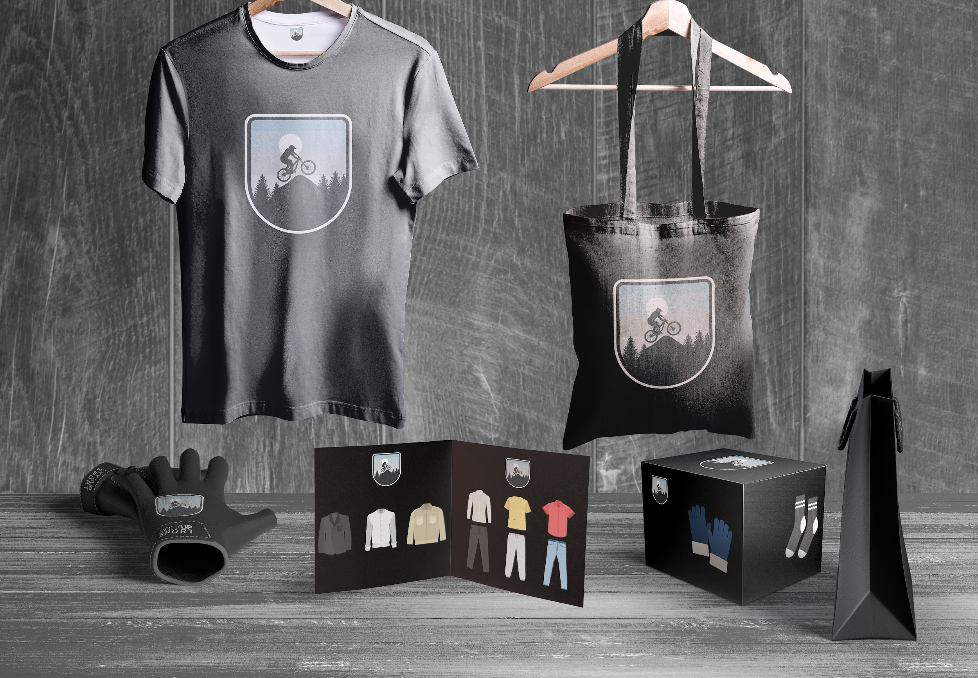
APPLICATIONS
Venus is a planet with a beautiful name and is the second one from the Sun. It’s terribly hot and its atmosphere is poisonous

Slide 35
Awesome Words

Slide 36
A Picture Is Worth a Thousand Words

Slide 37
4,550,000
Big numbers catch your audience’s attention

Slide 38
THANKS!
Do you have any questions? youremail@freepik.com +91 620 421 838 yourcompany.com
Please keep this slide for attribution.

Slide 39
ALTERNATIVE RESOURCES

Slide 40
RESOURCES
Images
Vectors
Black friday scene creator mock-up Free
Young man cycling in skatepark low angle shot
Sporty man extreme jumping with bicycle
Young man jumping with bicycle
Extreme sports banner
Collection of bicycle in flat design
World map business infographic
Mountain bike badge
Infographics timeline
Electronic devices mock-ups
Bicycle with equipment infographic

